Slide 1

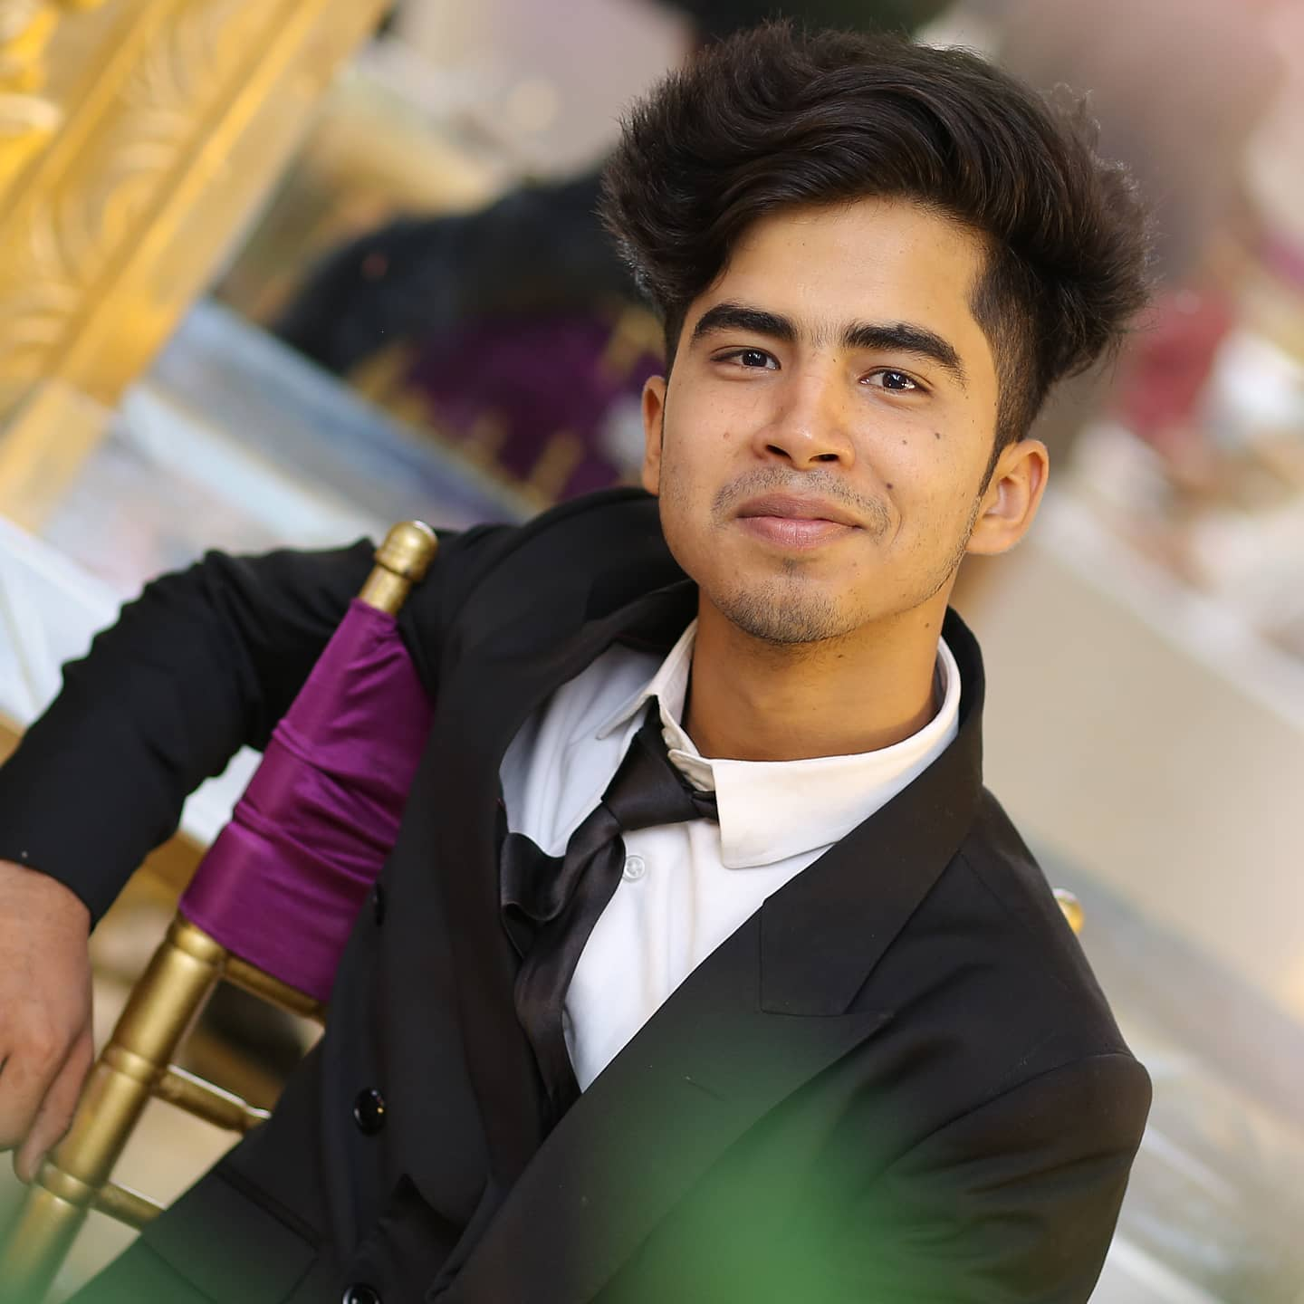
Personal Profile
Name: Abdullah Khan
ERP: 23956
Gender: Male

Slide 2

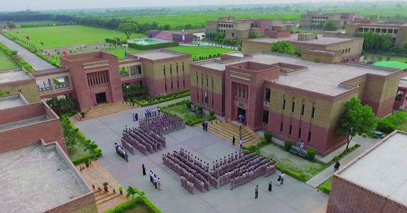
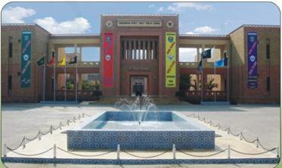
Education history
Primary and Secondary school from PAF Rashidabad
.

Slide 3
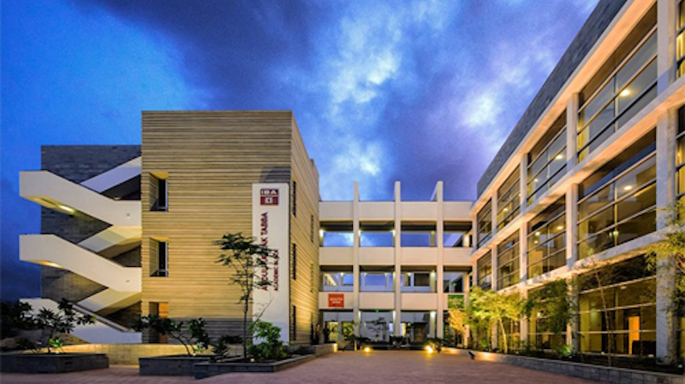
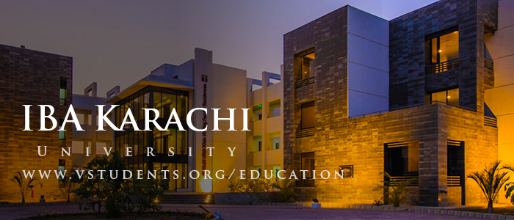
University Education from IBA Karachi, Pakistan

Slide 4



Work experience
Ismail Industries Limited(2 years)
Freelancing (1 year)

Slide 5




Hobbies and passion
Reading Books
Gaming
Watching Movies and TV Shows

Slide 6

Achievements
Gold Medal in All Pakistan Art Competition.
Distinction in all Sindh (Maths.)
1st in Mehran Debate competition.

Slide 7



Skills and languages
Graphic Designing
Sketching

Slide 8




Painting
Public Speaking

Slide 9
EXTRA CIRICULARS
Inter house winner of table tennis championship.
Winner of WSC Karachi round
Runners of up debate competition of Beaconhouse

Slide 10
COMMUNITY SERVICE
Head of social welfare drives for APWA COLLEGE Trust
Work for JDC and Sarim Burney Welfare

Slide 11
Personal Statement
I am Abdullah Khan, a fresh A levels graduate from PAF Rashidabad. Being a Future Business Student I feel that the importance of having hands on market experience is immense. It enables the person to grow exponentially and provides endless opportunities which is why I seek to do an internship.

Slide 12
THE
END

